Slide 1
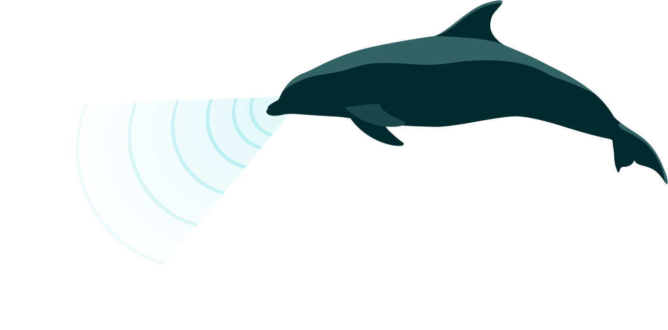
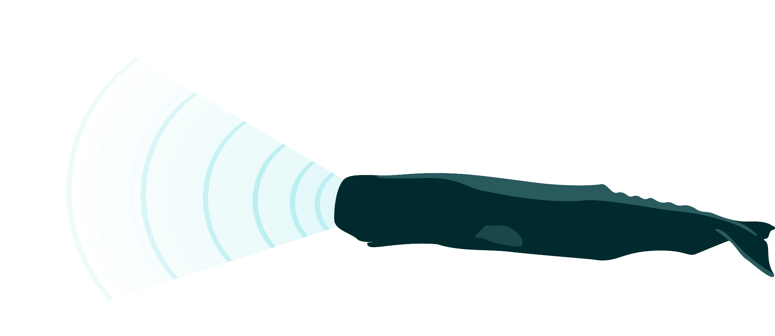
Distinguishing odontocetes
Annamaria DeAngelis
June 5, 2023

Slide 2
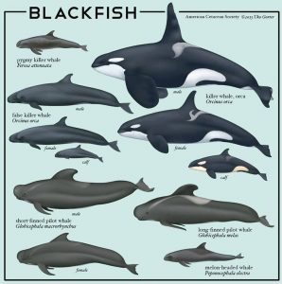
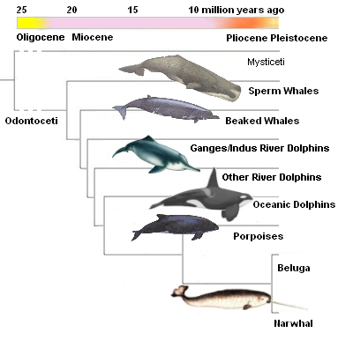
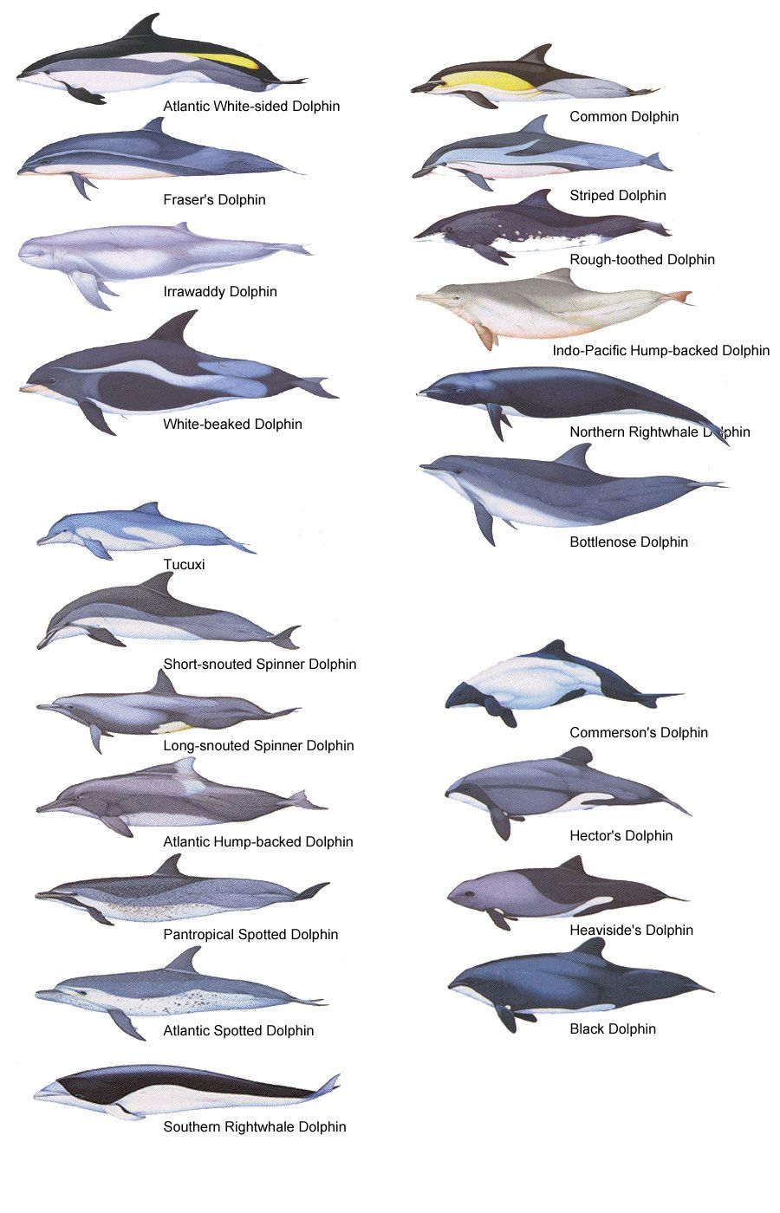
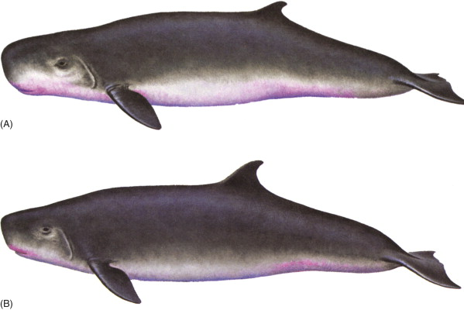
Members of the odontoceti
https://whale-tales.org/the-naming-of-things-blackfish/
Kogiidae
https://endangerednarwhals.org/evolutionary-history/
McAlpine 2018
https://www.pinterest.com/pin/234820568049824789/

Slide 3
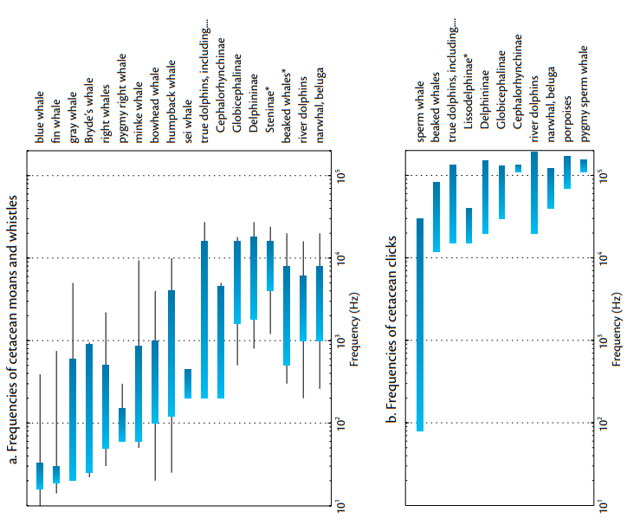
Members of the odontoceti
Working in kHz
Whistles are lower in frequency than clicks
Some species only click
100
100
10
10
1
1
Mellinger et al. 2007

Slide 4
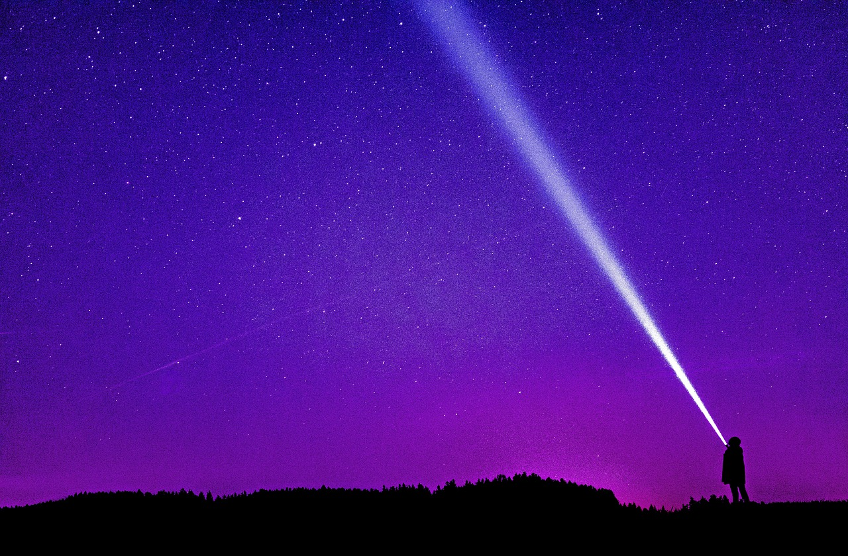
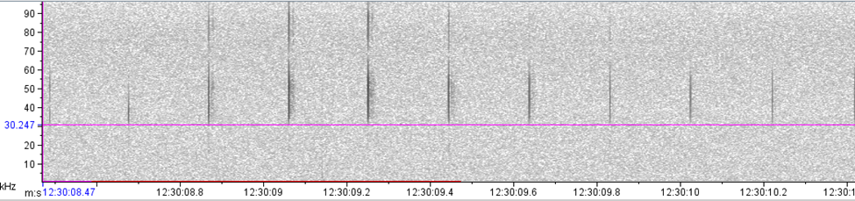
Directionality of clicks

Slide 5
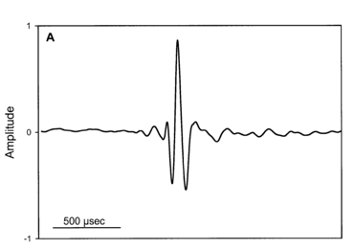
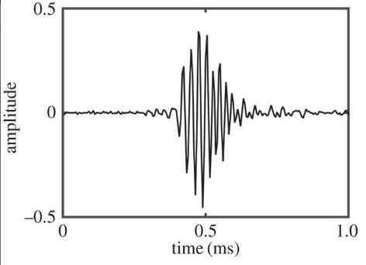
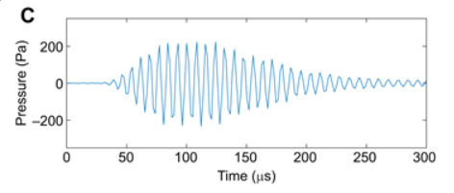
Gross click types
Impulsive
Frequency modulated
Narrow band high frequency
Madsen et al. 2002
Cholewiak et al. 2017
Malinka et al. 2021
Sperm whales
Delphinids (on-axis)
Beaked whales
Delphinids (off-axis)
Kogiidae
Porpoise

Slide 6
Discriminating between clicking species based on click interval
Beaked whale
Delphinidae
Pilot whale
Risso’s dolphin
0
0.2
0.5
1+
Kogiidae
Sperm whale
Porpoise
Inter-click-interval (seconds)
}

Slide 7
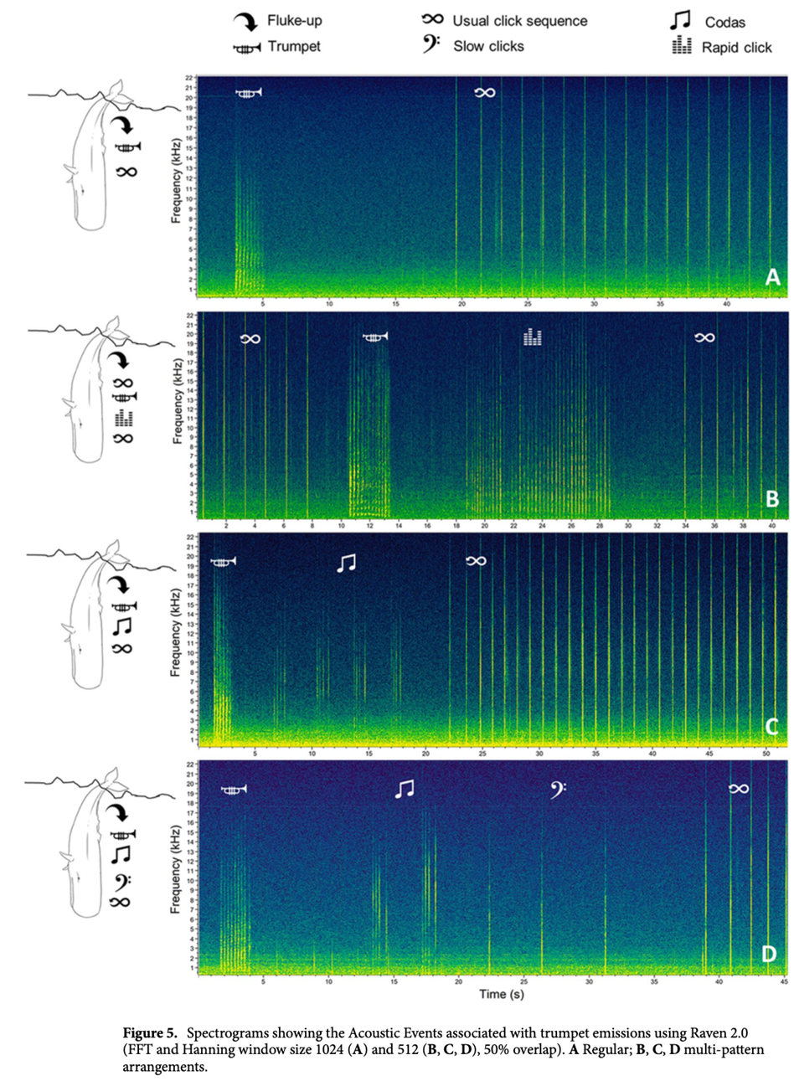
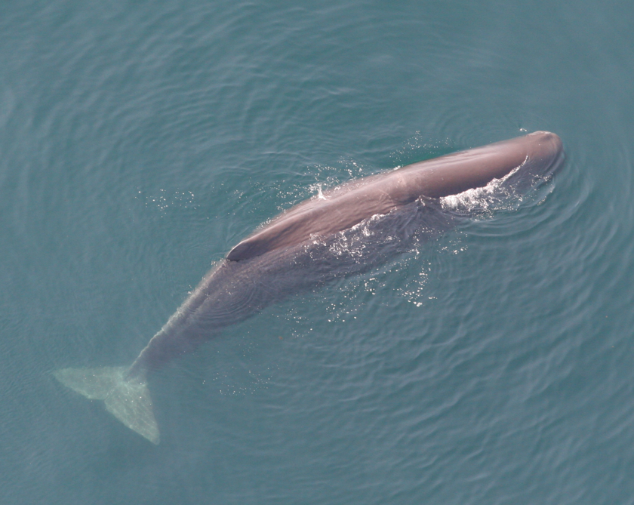
Sperm whales (click only)
NEFSC Permit #775-1875
\\stellwagen.nefsc.noaa.gov\stellwagen\OUTREACH\PICTURES_AND_SOUNDS\SOUND_AND_PHOTO_LIBRARY_2020\Cetaceans\Sperm_Whale_Phma\Phma_Sounds
Pace et al. 2021

Slide 8
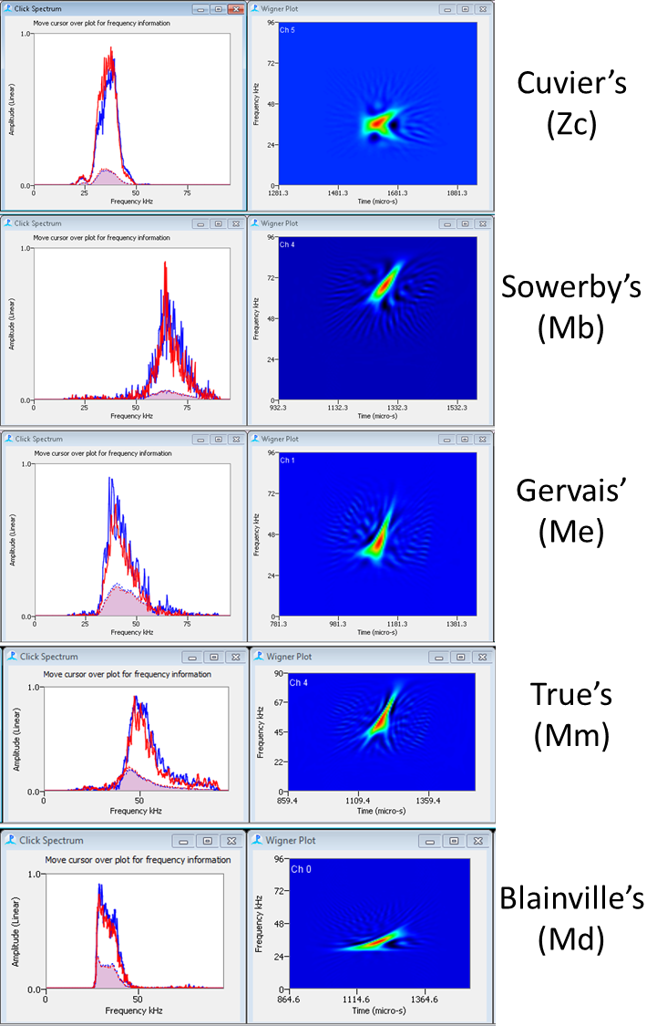
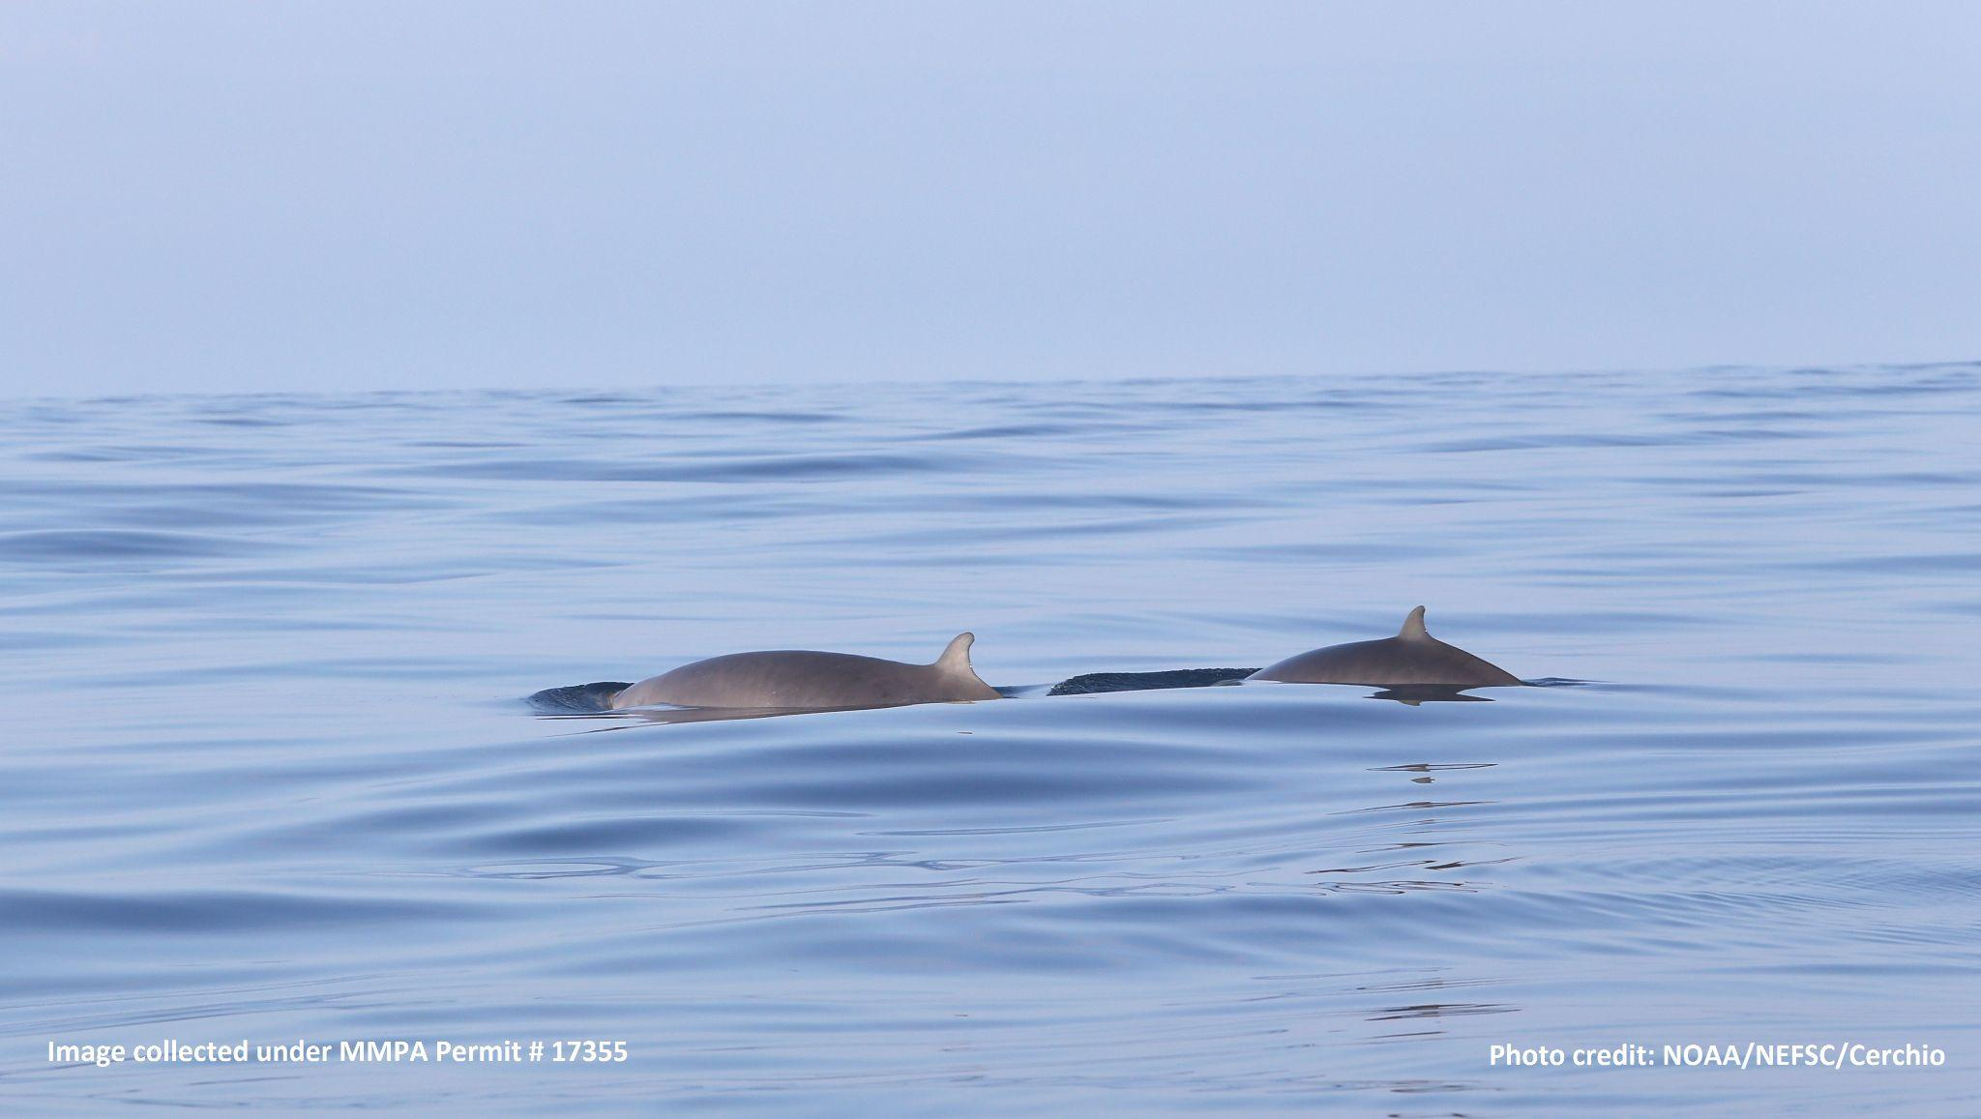
Beaked whales (click only)
Frequency modulated
Cholewiak et al. 2017

Slide 9
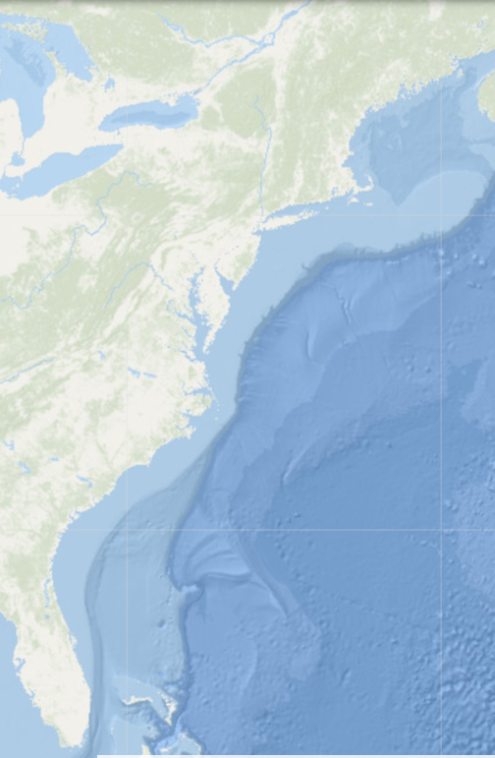
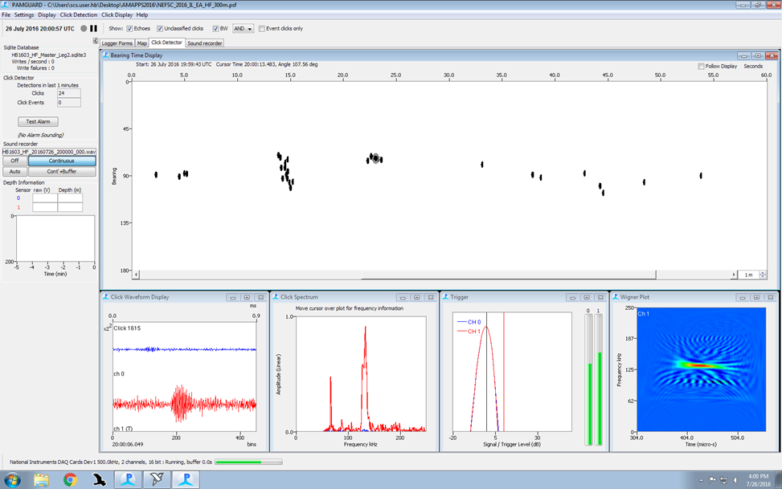
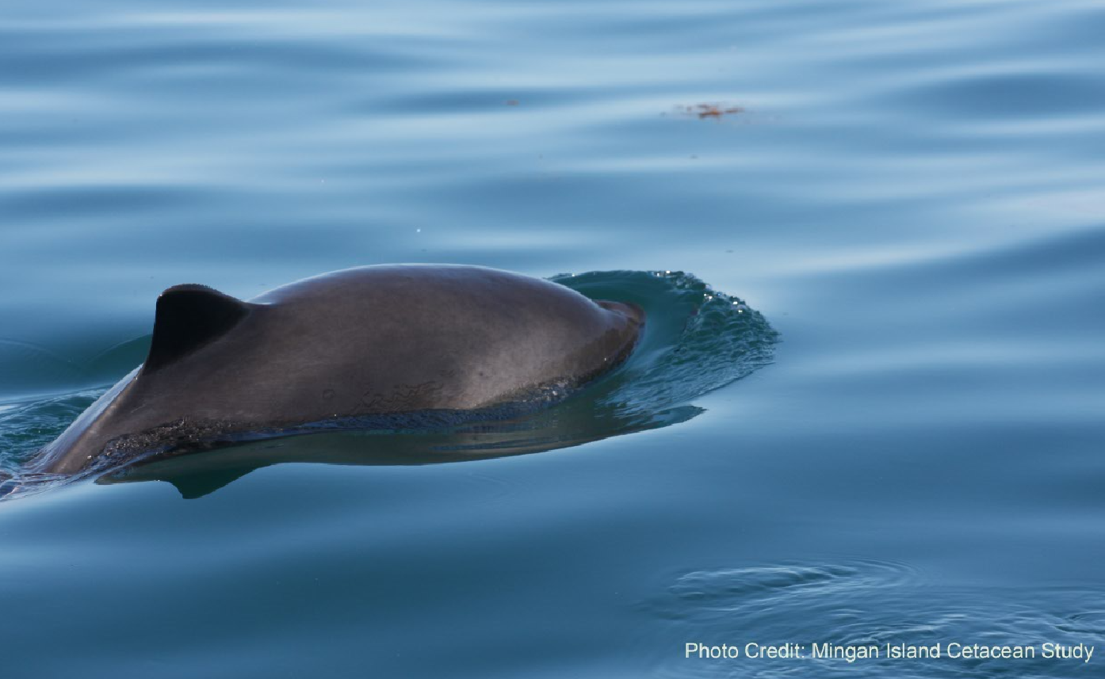
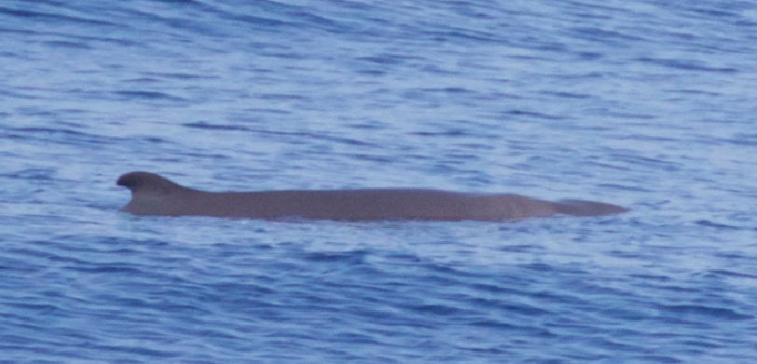
Kogiidae + porpoise (click only)
Narrow band high frequency
Porpoise
Malinka et al. 2021
Kogiidae
Harbor porpoise
Pygmy sperm whale
Photo credit: NEFSC/AMAPPS/Mike Force

Slide 10
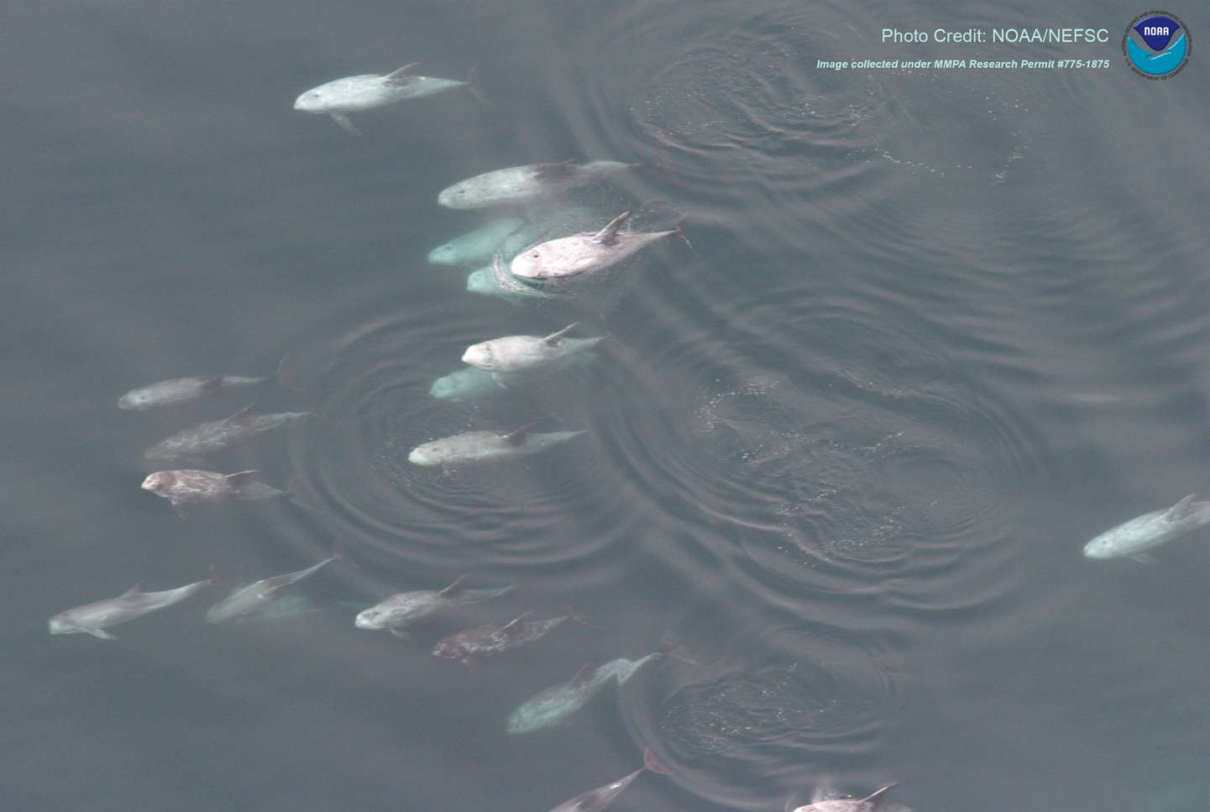
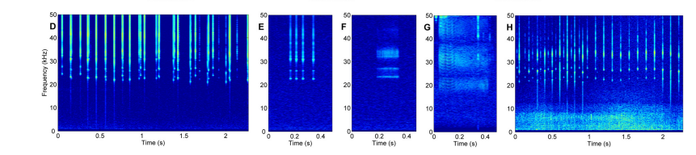
Dolphins that only click (N. Atlantic)- Risso’s
No spectral banding in bottlenose + common dolphins
Spectral banding in clicks
Soldevilla et al. 2017

Slide 11

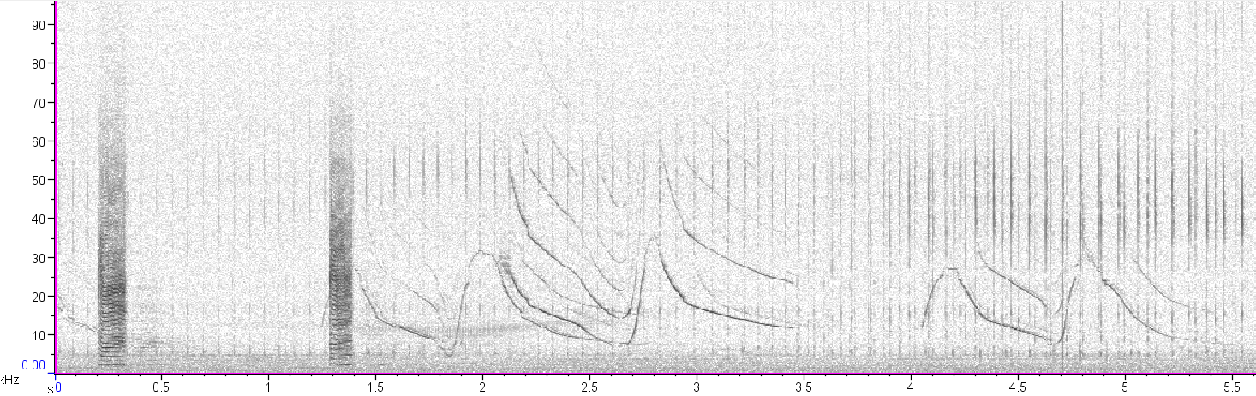
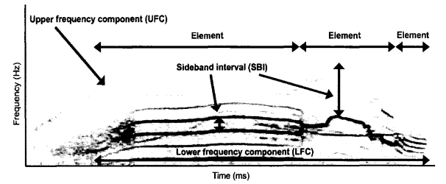
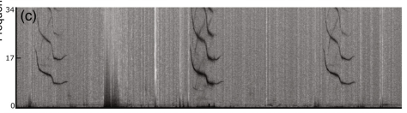
Dolphin whistle overview
Whistles
Continuous tonal sounds, few/no harmonics (Nemiroff & Whitehead 2009)
Burst pulses
Series of rapid clicks that sound tonal (e.g. squawks)
Pulsed calls
Broadband with tonals (Nemiroff & Whitehead 2009)
Species that can biphonate: belugas, narwhals, “blackfish”
Signature whistles
Stereotyped whistles often repeated
Reported species (N. Atlantic): bottlenose dolphins, Atlantic spotted dolphins, common dolphins
Nemiroff & Whitehead 2009
Cones et al. 2022

Slide 12
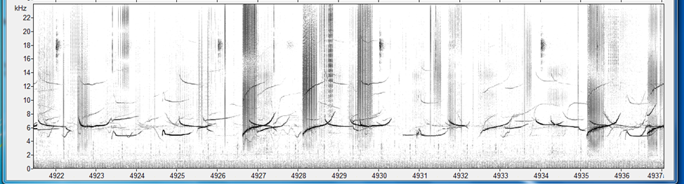
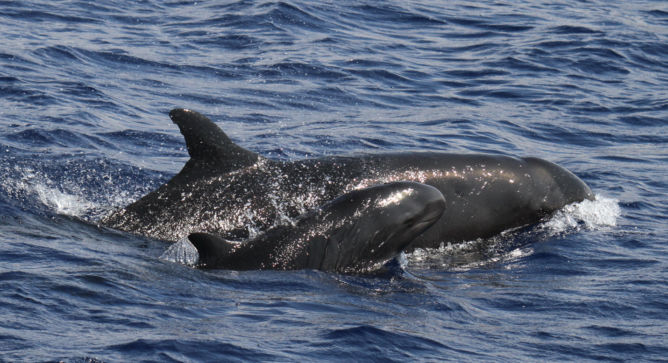
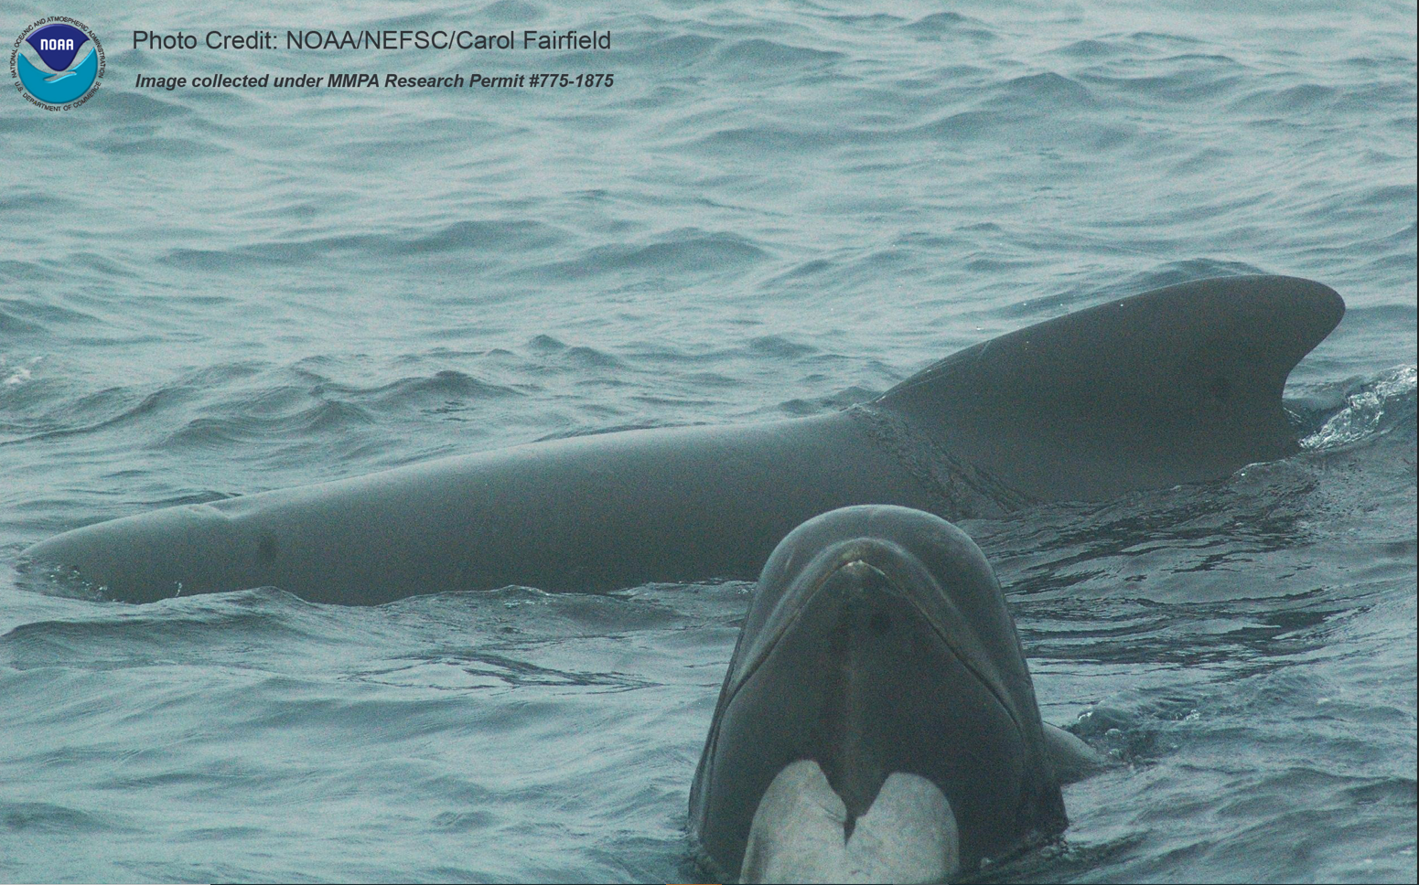
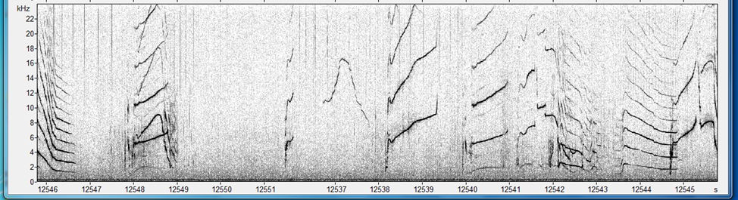
Example “blackfish”
Photo credit: Cascadia Research/Robin Baird

Slide 13
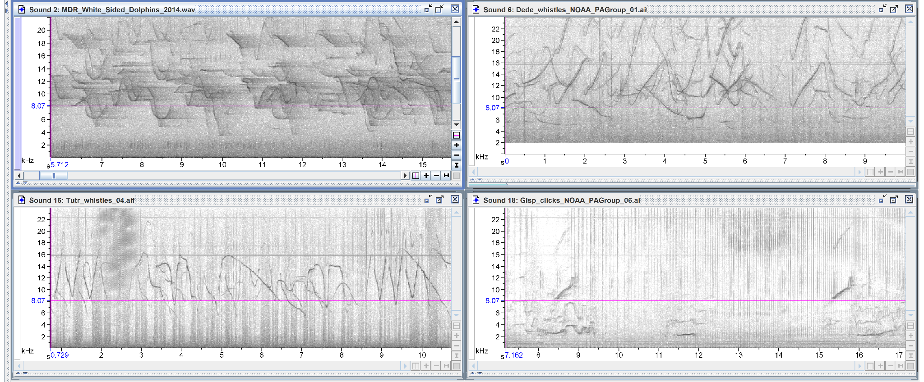
Example N. Atlantic Dolphins
\\stellwagen.nefsc.noaa.gov\stellwagen\OUTREACH\PICTURES_AND_SOUNDS\SOUND_AND_PHOTO_LIBRARY_2020\Cetaceans
Discriminating between dolphin species remains a challenge

Slide 14



Odontocete team
Annamaria DeAngelis
Team Lead
Annabel Westell
Sperm whale + coding extraordinaire
Amanda Holdman
Resident harbor porpoise + statistical wizard

Slide 15
References
Mellinger, D. K., Stafford, K. M., Moore, S. E., Dziak, R. P., & Matsumoto, H. (2007). An overview of fixed passive acoustic observation methods for cetaceans. Oceanography, 20(4), 36-45.
Pace, D. S., Lanfredi, C., Airoldi, S., Giacomini, G., Silvestri, M., Pavan, G., & Ardizzone, D. (2021). Trumpet sounds emitted by male sperm whales in the Mediterranean Sea. Scientific Reports, 11(1), 1-16.
Cholewiak, D., DeAngelis, A. I., Palka, D., Corkeron, P. J., & Van Parijs, S. M. (2017). Beaked whales demonstrate a marked acoustic response to the use of shipboard echosounders. Royal Society open science, 4(12), 170940.
Malinka, C. E., Tønnesen, P., Dunn, C. A., Claridge, D. E., Gridley, T., Elwen, S. H., & Teglberg Madsen, P. (2021). Echolocation click parameters and biosonar behaviour of the dwarf sperm whale (Kogia sima). Journal of Experimental Biology, 224(6), jeb240689.
Madsen, P., Wahlberg, M., & Møhl, B. (2002). Male sperm whale (Physeter macrocephalus) acoustics in a high-latitude habitat: implications for echolocation and communication. Behavioral Ecology and Sociobiology, 53, 31-41.
Nemiroff, L. (2009). Structural Variation and Communicative Functions of Long-finned Pilot Whale (Globicephala Melas) Pulsed Calls and Complex Whistles.
Cones, Seth, Molly Dent, Sam Walkes, Alessandro Bocconcelli, Christianna DeWind, Kayla Arjasbi, Kathryn Rose, Tammy Silva, and Laela Sayigh. "Probable signature whistle production in Atlantic white-sided (Lagenorhynchus acutus) and short-beaked common (Delphinus delphis) dolphins near Cape Cod, Massachusetts." (2022).
Soldevilla, M. S., Baumann-Pickering, S., Cholewiak, D., Hodge, L. E., Oleson, E. M., & Rankin, S. (2017). Geographic variation in Risso's dolphin echolocation click spectra. The Journal of the Acoustical Society of America, 142(2), 599-617.
McAlpine, D. F. (2018). Pygmy and dwarf sperm whales: Kogia breviceps and K. sima. In Encyclopedia of marine mammals (pp. 786-788). Academic Press.

